Slide 1

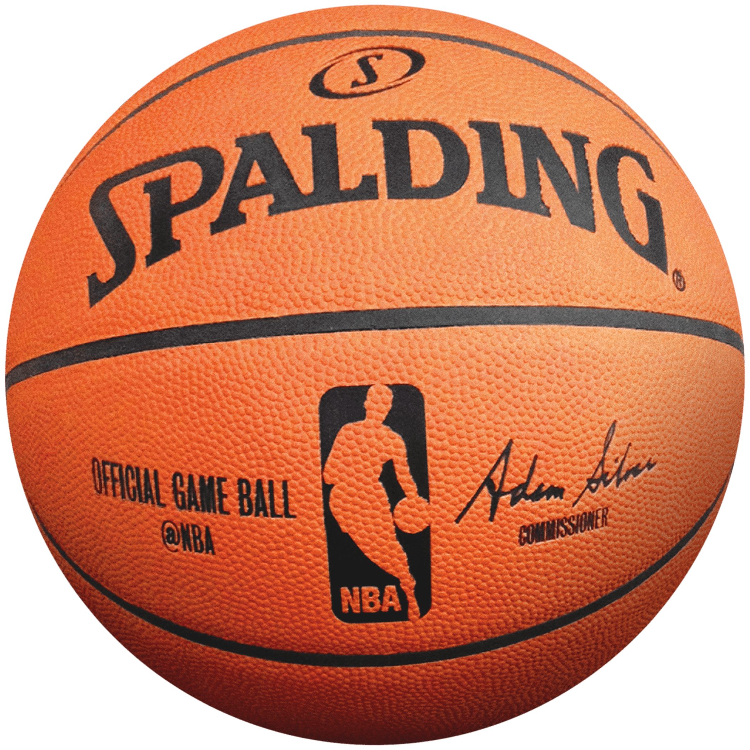
Draft Classification
Jaden Lin
Notes:
Obtaining talent is a critical focus point for executive running an NBA team because it can often have a huge impact in a team success
One being the NBA DRAFT where teams take turns selecting player from a pool of athletes
More so just impacting a teams individual performance, often it can change a whole culture and style of the entire league
And this is what we will be focusing on

Slide 2
Process
SportsReference/Kaggle
Free python API data of collegiate Atheletes / NBA Draft data
Classification Models
Logistic Regression / Support Vector Machine
Data Cleaning/Exploration
What information can we gather from our data
Interpretation
What insight can we get from our model
Notes:
The data was collected from SportsReferences and Kaggle
18 years of collegiate athletes in game statistic
Sportsreference is a database of collegiate athletes with stats like height weight career points assist etc
Data Cleaning
-organize, impute,remove data
So we can get a clearer picture of what the data is tell us
After this data is clean we pass it classification models
And then we can interpret the results

Slide 3
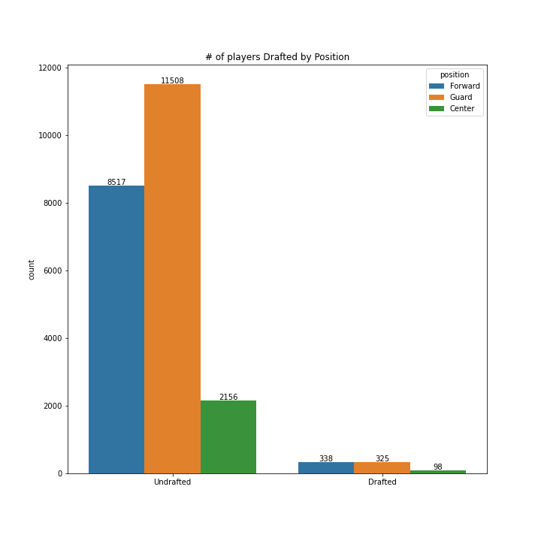
Total
Undrafted : 23,316
Drafted : 761
Notes:
Like previously mentioned this data is a span of 18 years
In those 18 years there were over 24,000 eligible athletes just 761 were drafted
Thats ~3% overall are drafted this may seem like a low percentage, well it is,
Each year 60 new incoming players are added to a population of 400 can make quite a difference
Now when we see this chart we immediately see a discrepancy between the number of drafted centers to their counterparts
It could be because there were less Centers overall, infact the probability that you were drafted given you are a center is higher than if you were a guard or forward

Slide 4
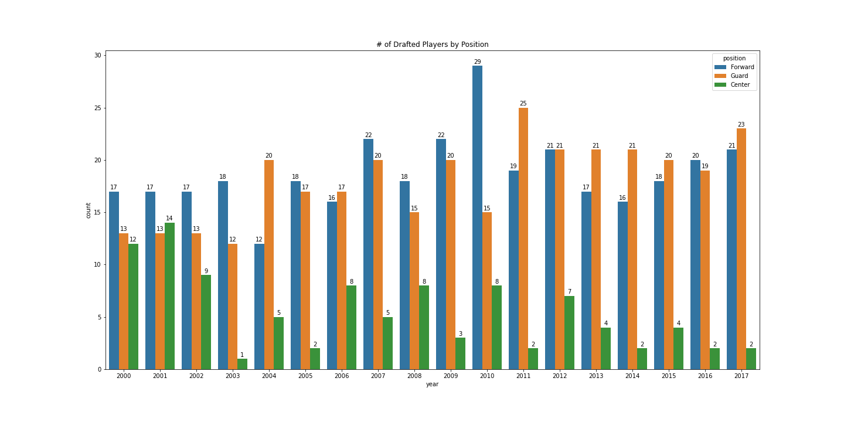




2018
(11.4/32)
2012
(6.4/18.4)
# of C drafted <2000 according to wiki
1998 : 16
1999 : 13
Notes:
But looking at it by year
We see a trend of decline
The data only went back to 2000 so i looked up the # of drafted Centers 2 years earlier
16, 13
Just by looking at this we can come to a safe conclusion that Centers are being drafted less and less
Infact since 2010, 31 Center were drafted and only 8 of them remain in the NBA of the 8 only 2 of them were all star
Teams have found success in drafting Forward whom are at least 6’9 and are able to shoot at a decent % like Anthony Davis and Karl Towns

Slide 5
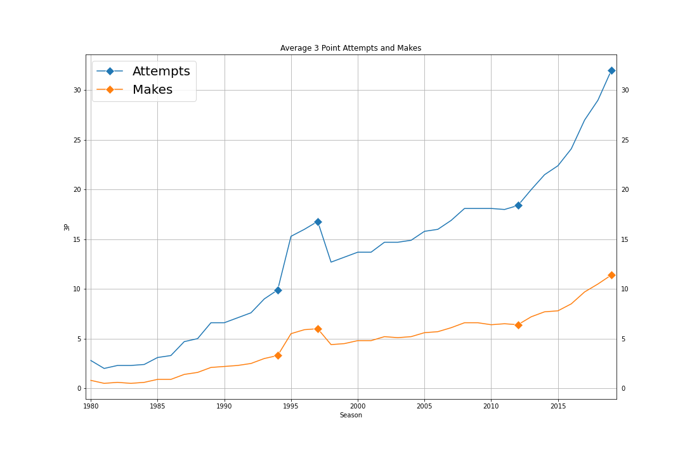
2018
(11.4/32)
2012
(6.4/18.4)
Notes:
On the note of Shooting, 3 point attempts and makes have been on the rise
Since 2012 the NBA average for attempts and makes has increased year by year. As this trend catches on more and more Centers are less likely to be drafted and in their place are players like Anthony Davis and Karl Towns to replace them.
Previously in 1994 the nba attempt to increase point averages by moving the 3 point line closer, which is why we see a spike in makes and attempts.
But they revert it back because players just weren’t making them at a good percentage to increase the overall score

Slide 6
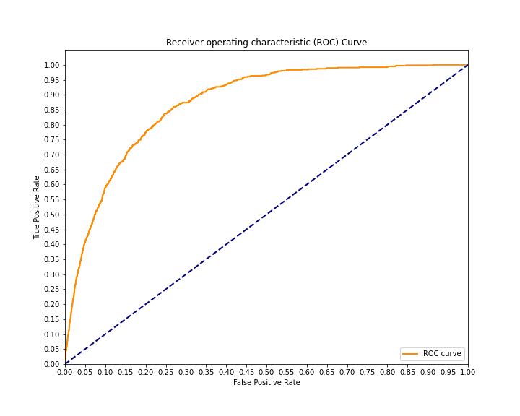
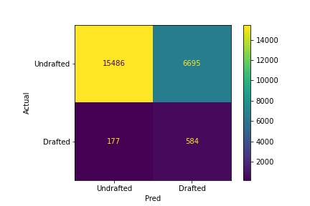
Logistic Regression
Accuracy : 27%
AUC : 0.8711
Notes:
Accuracy - 79%
Model was able to classify 397 players correctly and 106 incorrectly
TP : 197 Correctly predicted as Drafted
TN : 200 Correctly predicted as Undrafted
FP : 53 Incorrectly predicted as Drafted -
FN : 53 Incorrectly predicted as Undrafted
By plotting a ROC curve we can use this graph as a baseline to see how good our model is. The area under the curve is 0.87

Slide 7
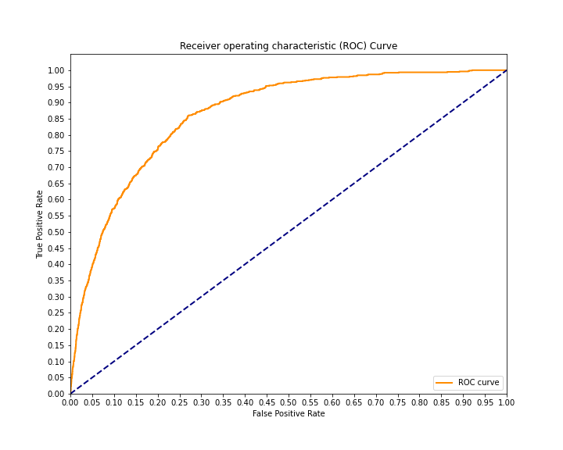
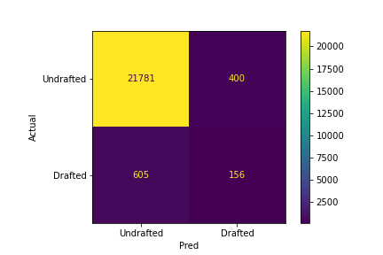
Support Vector Machine
Precision : 28%
AUC : 0.86514
Notes:
Accuracy - 80%
Model was able to classify players 400 correctly and 103 incorrectly
TP : 207 Correctly predicted as Drafted
TN : 193 Correctly predicted as Undrafted
FP : 60 Incorrectly predicted as Drafted -
FN : 43 Incorrectly predicted as Undrafted
With an AUC of .88

Slide 8
Conclusion
Notes:
In a landscape where the style of play is evolving at such a rapid pace, the ability to understand the players of the upcoming generation becomes integral. To separate the capable and incapable is a big decision amongst those that run multi-million dollar teams, and can be a huge deciding factor of a team's success and the overall aspect of entire league. There is still a lot of further research needed before the models can be deemed useful/actionable but I think it a great place to learn and understand the problem.
The best model for what I was trying to solve is best to have high True Positives and limit False Positive
With that being said the better model was Support Vector Machine at 80% and area under the curve of 0.88.

